Slide 1
Online Safety Evening
Wednesday 17th January 2018 6.00-7.00pm
thatcherd@piggottschool.org

Slide 2
Parenting in the digital age

Slide 3
Online Safety Evening
Purpose of this evening:
Raise awareness of online safety
Highlight the development of technology
Discuss online safety “CONTENT – CONTACT – CONDUCT”
Focus on the risks that young people face online
Develop ways to support young people to use the internet safely

Slide 4
Internet Matters

Slide 5
“My kids know more about the internet than I do…”

Slide 6
Penetration rate: Years to reach c.50m users
Radio 38 years
Phone 75 years
TV
13 years
Mobile 12 years
14 days
iPod
3 years
Facebook
3.5 years
Web
4 years
YouTube 1 year
35 days
L. Rosen, 2014

Slide 7
There are lots of positives…
Online games can enhance teamwork and creativity
Add to the child's store of knowledge
Households with computers perform better academically
Improve both visual intelligence and hand-eye coordination
Research shows the outcomes for children are better
if they benefit from connected technology
EU Kids Online 2013

Slide 8
But technology can affect children’s development…
Sleep cycles are affected by blue light from screens
Screen-based entertainment increases central nervous system arousal
Can be more forgetful than OAP’s
One study found that the more distracted you are the less able you are to experience empathy

Slide 11
THE DIGITAL WORLD

Slide 12
Risk is not harm. Positive action can limit risks becoming harmful
6 tips for parents:
1
Understand the risks!
2
Communicate regularly!
3
Keep the risks in proportion!
4
Agree helpful mediation strategies!
5
Develop coping strategies that foster resilience!
6
Expect technology to develop faster than you think!

Slide 13
Mobile Apps
Do you know your child’s favourite apps?
Are the apps age appropriate?
Notes:
Ask your audience the following:
Do you know your child’s favourite apps?
Does your child use your phone, are your apps age appropriate?
There truly is an app for everything. From online banking, to finding out where your bus is, apps have become overwhelmingly popular with adults and children of all ages. They are there to make our lives a little easier on the go, but also for entertainment. Many pre school children's first encounter with the online world is through their parent’s or family member’s phone or tablet.
Ask the parents and carers to talk with their children about the apps they have downloaded, are they age appropriate, is there a cost, do they link to other services and if so, what information are they sharing on them?

Slide 15
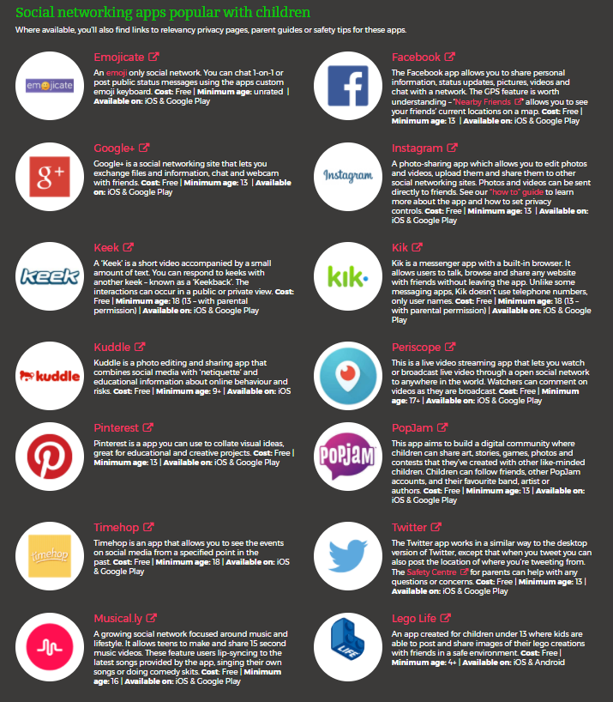

Slide 16
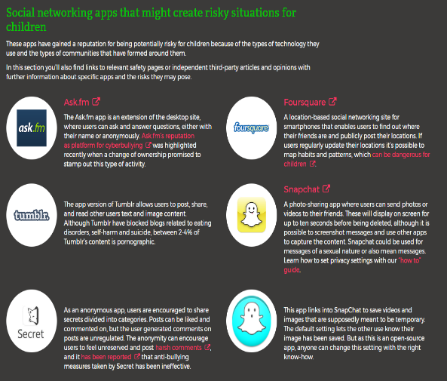
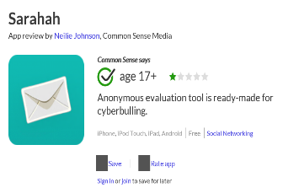

Slide 17
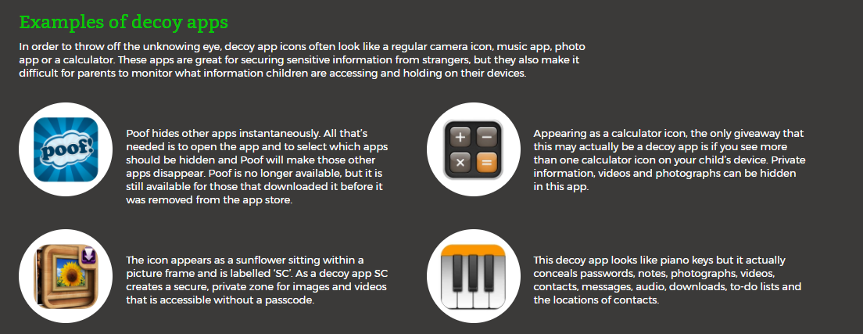
Other things to be aware of:
Fake profiles
Dual profiles
Help guides for each app!

Slide 18
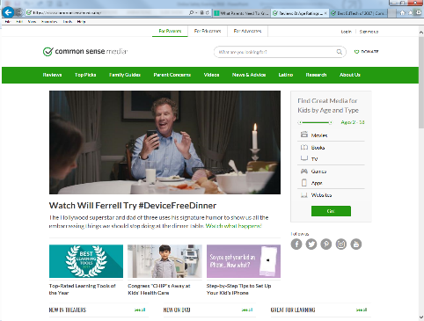
Commonsensemedia.org

Slide 19
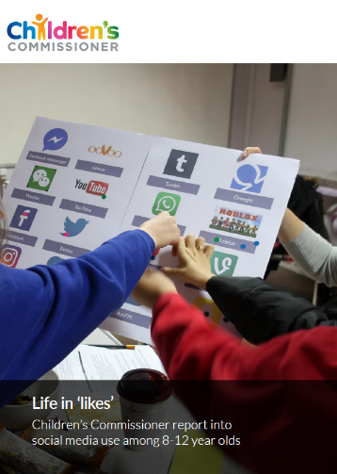
LIFE IN ‘LIKES’: CHILDREN’S COMMISSIONER REPORT INTO SOCIAL MEDIA USE AMONG 8-12 YEAR OLDS

Slide 20
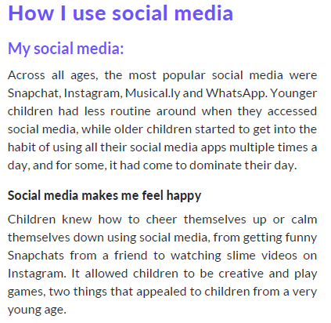
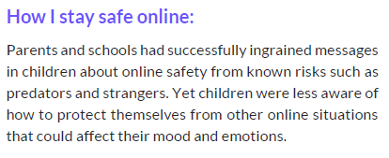

Slide 21
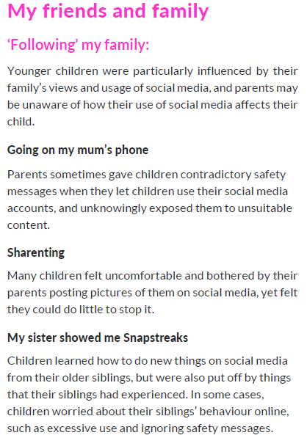
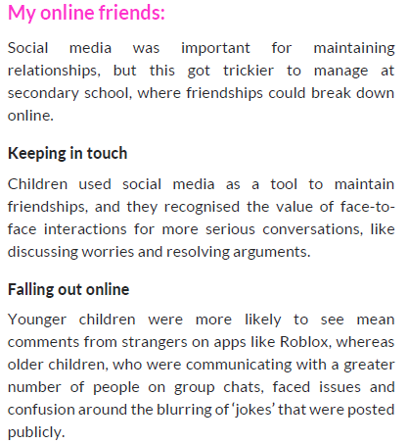

Slide 22
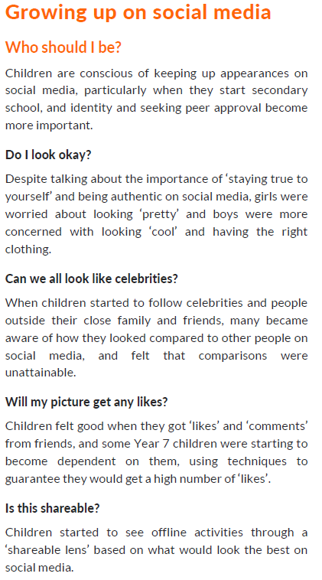
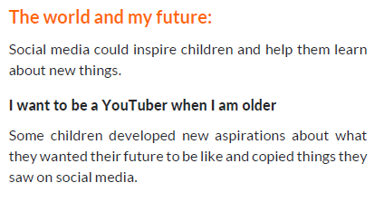

Slide 23
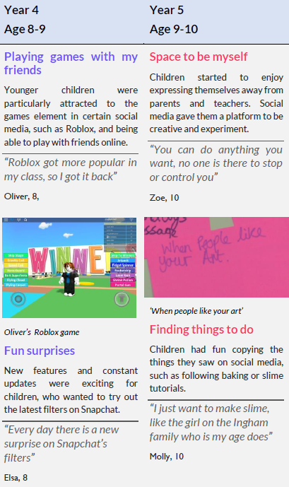

Slide 24
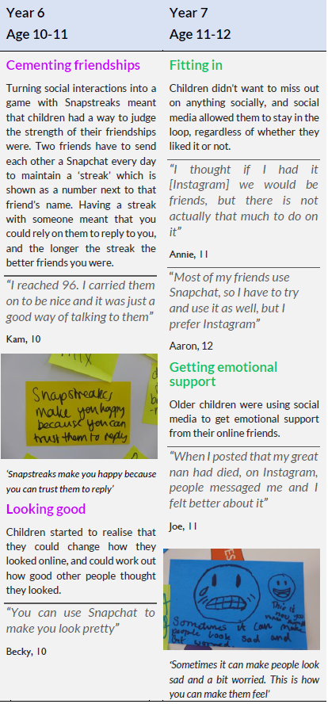

Slide 25
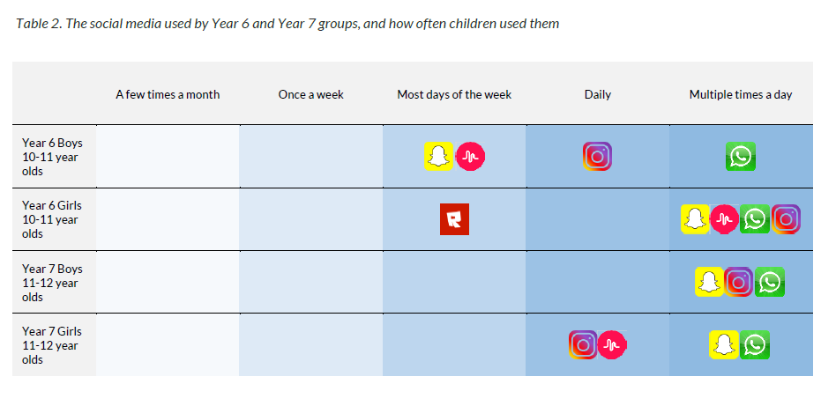

Slide 26
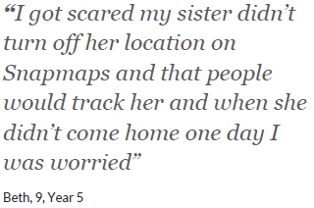
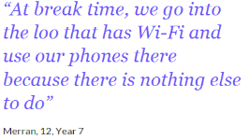
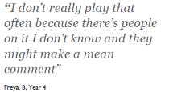
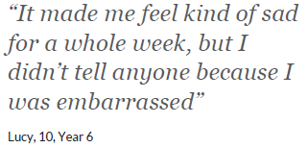
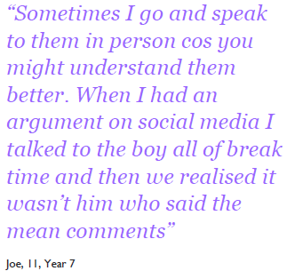
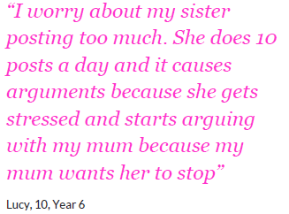
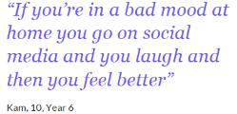

Slide 27
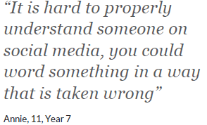
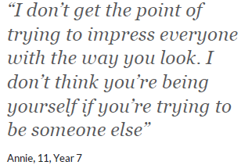
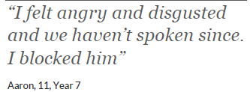
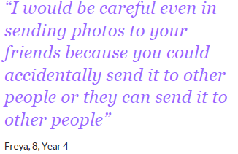
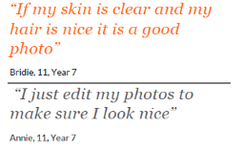
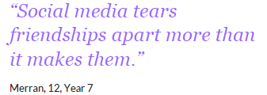

Slide 28
How children are using the internet

Slide 29
And there are of course risks…
 | Content the things you see! | Contact The people you have contact with! | Conduct How you and others act when they are online!

Slide 30
11yrs
Dealing with inappropriate CONTENT
4.7m
URL’s showing pornographic content
More than 12% of the internet
1/3
of children have seen explicit images by age of 10
Average age to first view pornographic content online

Slide 31
Dealing with inappropriate CONTENT
What to talk about
They can come to you if they see anything that upsets them
If they have seen pornography…that it presents an unrealistic image of sex and relationships
The importance of respect for each other and the meaning of consent
Top tips / tools to use
Parental controls on home broadband
Content lock on mobile networks
Safe search on Google (& other browsers) & YouTube; child –friendly search engines

Slide 32
Dealing with inappropriate CONTACT
48%
of secondary school children have talked to strangers on social media
48%
of 11 year olds have a social media profile

Slide 33
Dealing with inappropriate CONTACT
What to talk about
Sometimes people hide behind fake profiles for dishonest reasons
Agree how they will respond to requests from people they don’t know in real life
Never ever to meet up with anyone they don’t know in real life
Top tips / tools to use
Set up safe social media profiles that don’t share personal information
Turn off geo location settings on devices
Use the strongest privacy settings on social media
Learn how to report / block/ mute

Slide 34
Dealing with inappropriate CONDUCT
25%
of children will experience cyberbullying
50%
of children say someone has been nasty online

Slide 35
Dealing with inappropriate CONDUCT
What to talk about
Talk to a trusted adult if they experience anything upsetting online
Think carefully about sharing images of others
Be responsible online, remembering they are creating their own digital footprint
Top tips / tools to use
Report inappropriate posts/content to the social media providers
Think carefully about using monitoring apps that identify inappropriate behaviour

Slide 36
What are the main issues young people are having to deal with? CYBERCULLYING SEXTING GROOMING *SOCIAL MEDIA *GAMING

Slide 37
Definition
The Anti-bullying Alliance define bullying as:
The repetitive, intentional hurting of one person or group by another person or group, where the relationship involves an imbalance of power. Bullying can be physical, verbal or psychological.
….Cyberbulying is the new kid on the block.
Bullying has
evolved

Slide 38
Why is cyberbullying different?
Hard to escape
Instantly reach audience
Relentless
24hour access
Anonymity
Hard to police

Slide 39
How to protect your child

Slide 40
Guide your child to be safe online
Think before
you post
Be share aware
Top tip – have a family agreement Like this example by Childnet
Be a good role model
Time online
Get involved

Slide 41
Have great internet manners
1
2
3
Treat others as you would like to be treated
People can’t see your body language, facial expressions or hear the tone of your voice online- so don’t over-use icons and punctuation to convey meaning
If you wouldn’t say it to someone in person don’t say it online
4
5
6
Don’t start
rumours
Don’t make a situation worse by provoking people even more
Don’t make fun of someone
in an online chat
Or spread gossip about someone online

Slide 42
Have great internet manners
8
9
7
Make sure you don’t create a negative environment in an online world or game through name calling
Include people in online games and social forums, and don’t intentionally leave people out
Post things that will inspire and motivate people in a positive way
10
11
BLAH
BLAH BLAH
Respect other
people’s privacy
BLAH_{BLAH}
You can’t retrieve material once it’s sent or posted online so if it might embarrass you or someone, don’t put it online
BLAH

Slide 43
Safe social media profile
1
5
Use a strong
password
Change settings to private
6
2
Consider the
Minimum age
Use an alias and avoid
personal pictures
7
Don’t accept friend requests from strangers
3
Don’t include date of birth and other personal information
8
Switch off location services
4
Show your child how to block and report
9
Tell them to think
before they post – MAKE GOOD ONLINE DECISIONS!

Slide 44
Dealing with Cyberbullying

Slide 45
Spotting the signs
62%
of parents worry about Cyberbullying
1 in 10
parents are aware their child has been bullied
Change in behaviour
Avoiding talking

Slide 46
The do’s
!
Block
Report
Keep the evidence
Know when to take it further

Slide 47
The don’ts
Retaliate
Stop them going online
Deal with it alone
Stop when the bullying stops

Slide 48
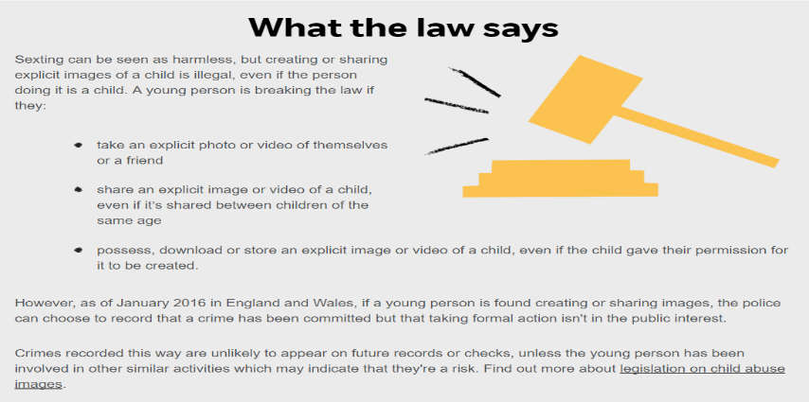
Sexting

Slide 49
Dealing with ‘SEXTING’
What to talk about
It’s hard to control where images might be shared
It’s illegal to create or share a sexual image of a child under 18
Top tips / tools to use
The T-shirt test – if you wouldn’t wear the picture on your T-shirt, don’t share online
If you child is involved in sexting contact CEOP & Childline who can help to remove images
15-40%
of young people are involved in sexting
Threat comes mostly from peers and is often coercive

Slide 50
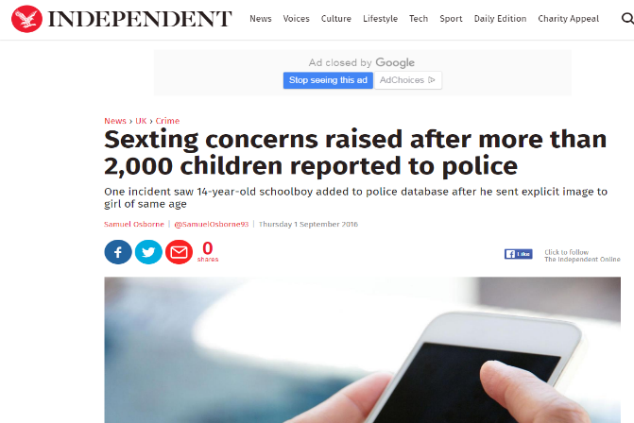

Slide 51
Grooming
What is ‘online grooming’?
“Grooming is a process used to prepare a child for sexual abuse. An offender’s aim when grooming will be to gain access to a child and build a relationship with that child.
Grooming can take many different forms, from one off contact which may include sexual advances, to a series of events over time.
It may start with an adult scanning websites to identify a vulnerable child or befriending a child, perhaps by pretending to have common hobbies or interests or using flattery to trick a child into trusting them
Notes:
Ask the audience how they believe grooming to ‘work’ online? What does an online friend mean to your child? Is it the same for you?
How would an offender make contact with a child?
Play embedded film which was produced by CEOP
“Grooming is a process used to prepare a child for sexual abuse. An offender’s aim when grooming will be to gain access to a child and build a relationship with that child. Grooming can take many different forms, from one off contact which may include sexual advances, to a series of events over time. It may start with an adult scanning websites to identify a vulnerable child or befriending a child, perhaps by pretending to have common hobbies or interests or using flattery to trick a child into trusting them.
Online it is easier for an offender to lie and gain one to one contact with a child, for example through a social networking or gaming site. They can share images or videos relating to their pretended common interests and build a ‘relationship’ away from any adult supervision.
Once a relationship is established an offender may then introduce sexual themes to the conversation, for example, asking the child about their sexual experiences, sharing pornography with them or asking them for sexual pictures of themselves. Different offenders will have different approaches so whereas this process may be very quick it can also take days, weeks or even months. Often an offender will attempt to get a child to meet them in the real world in order to abuse them. Increasingly some offenders are also persuading children to perform sexual acts on webcam.”

Slide 54
Controlling tech time
Your children will be watching the way you use technology and they will copy; make sure there is some consistency in how you role model good behaviour:
1
Turn off notifications on apps to avoid that constant ‘ping’
2
Buy an alarm clock so you don’t have devices in the bedrooms
3
Keep phone on silent in your pocket or bag when you pick the kids from school
4
No phones at the table rule or no phones between 6 and 7 rule
5
Family tech free days!

Slide 55
Controlling tech time
And there are tactics you can put in place to help manage their screen time….
Set a good example
Talk together about the time spent online
Agree on appropriate length of time they can use their device
Get the whole family to unplug & create screen free zones
Use technology / apps to help manage screen time e.g. Forest
App

Slide 56
Three things to teach your child
Be a confident communicator
Be a critical thinker Be a capable tools user

Slide 57
Other useful support services
Child Exploitation & Online Protection Centre
For concerns about online sexual abuse or the way someone has been communicating online ceop.police.uk/CEOP-Reporting/
NSPCC Net Aware
A guide to social networks that children use net-aware.org.uk/#
Childline 0800 1111
24 hour free helpline service for children and young people

Slide 58
@im_org
InternetMatters
Internet Matters
Helping parents keep their children safe online

Slide 59
Report and Support
Report suspected online grooming – this could include sexual chat, a child being asked to do something that makes them feel uncomfortable or someone insisting on meeting up .
www.ceop.police.uk
24 hour confidential helpline for children and young people .
Notes:
Inform the audience that there are support and report services available to them and their child.
Further information on CEOP - “If your child has been approached by an adult online. This contact could involve sexual chat, being asked to do something that makes them feel uncomfortable or someone insisting on meeting up. Contact CEOP at – www.ceop.police.uk”
Further information on Childline - “Sometimes children feel like they don’t want to talk to anyone in there family about what's happening to them. Inform them you are always there to listen, but if this ever becomes the case, there are experienced councillors at childline (24/7) who are there for them.”
[Content below is taken from a CEOP Grooming factsheet, available for download]
“The Child Exploitation and Online Protection Centre (CEOP)
CEOP is a police led, child protection agency which specialises in tackling sexual abuse on and offline. Through its Education Programme, Thinkuknow CEOP offers a range of safety information for children, young people, practitioners and parents/carers. For more information visit www.thinkuknow.co.uk/parents.
Reporting to CEOP
If someone has acted inappropriately towards your child, it may be sexual chat, being asked to do something that makes you feel uncomfortable or someone being insistent on meeting up. You must report it to ClickCEOP at www.ceop.police.uk.” Taken from a CEOP Grooming factsheet, available for download.

Slide 60
Online Safety Evening
Any questions?

